Slide 1
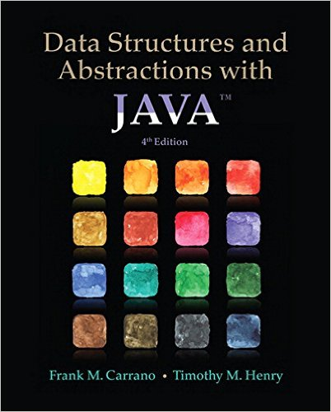
Lecture 6
Chapter 8: An Introduction to Sorting

Slide 2
Contents
Organizing Java Methods That Sort an Array
Selection Sort
  Iterative Selection Sort
  The Efficiency of Selection Sort

Slide 3
Contents
Insertion Sort
  Iterative Insertion Sort
  Recursive Insertion Sort
  The Efficiency of Insertion Sort
  Insertion Sort of a Chain of Linked Nodes
Shell Sort
  The Java Code
  The Efficiency of Shell Sort
Bubble Sort
Comparing the Algorithms

Slide 4
Objectives
Sort array into ascending order using
  Selection sort
  Insertion sort
  Shell sort
  Bubble Sort
Sort a chain of linked nodes into ascending order using insertion sort
Assess efficiency of a sort, discuss relative efficiencies of various methods

Slide 5
Sorting
Arranging things into either ascending or descending order is called “sorting”
This chapter discusses, implements simple algorithms that sort items into ascending order
  Sort into descending order with a few changes
In Java, possible to create class of static methods which sort objects of an array

Slide 6
Sorting Algorithms Categorized by:
the number of comparisons
  comparison-based sorting algorithms evaluate the elements of the list by key comparison operation
  non-comparison based sorting algorithms do not compare elements to each other; they may impose few restrictions on the inputs
the number of swaps
memory usage
  some sorting algorithms are “in place”
  some require memory to create auxiliary locations for sorting the data temporarily
recursion
  sorting algorithms are either recursive or non-recursive, and there are some algorithms which use both

Slide 7
Sorting Algorithms Categorized by:
stability
  a sorting algorithm is said to be stable if two objects with equal keys appear in the same order in sorted output as they appear in the input array to be sorted.
    suppose we have a list of 5-letter words: peach straw apple spork. If we sort the list by just the first letter of each word then a stable-sort would produce: apple peach straw spork. In an unstable sort algorithm, straw or spork may be interchanged, but in a stable one, they stay in the same relative positions.
  why is it important?
    suppose we have a list of first and last names. We are asked to sort "by last name, then by first". We could first sort (stable or unstable) by the first name, then stable sort by the last name. After these sorts, the list is primarily sorted by the last name. However, where last names are the same, the first names are sorted.

Slide 8

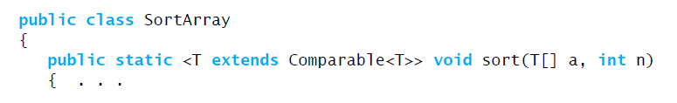
Sorting an Array
For an array to be sortable, objects must be comparable
  Must implement interface Comparable
We could begin our class with

Slide 9
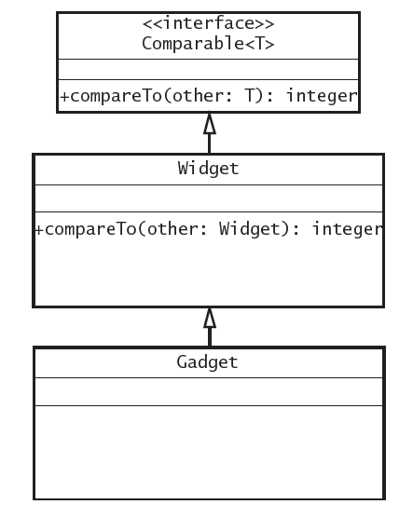
In the above example the class Gadget is derived from the class Widget, which implements the interface Comparable. Gadget does not need specific compareTo method, can use Widget’s
Instead of comparing an object of T only with other object of T, we can allow comparisons of objects of a superclass of T by writing: <T extends Comparable<? super T>>
we will change the header of method sort to be:
public static <T extends Comparable<? super T>> void sort(T[] a, int n)

Slide 10
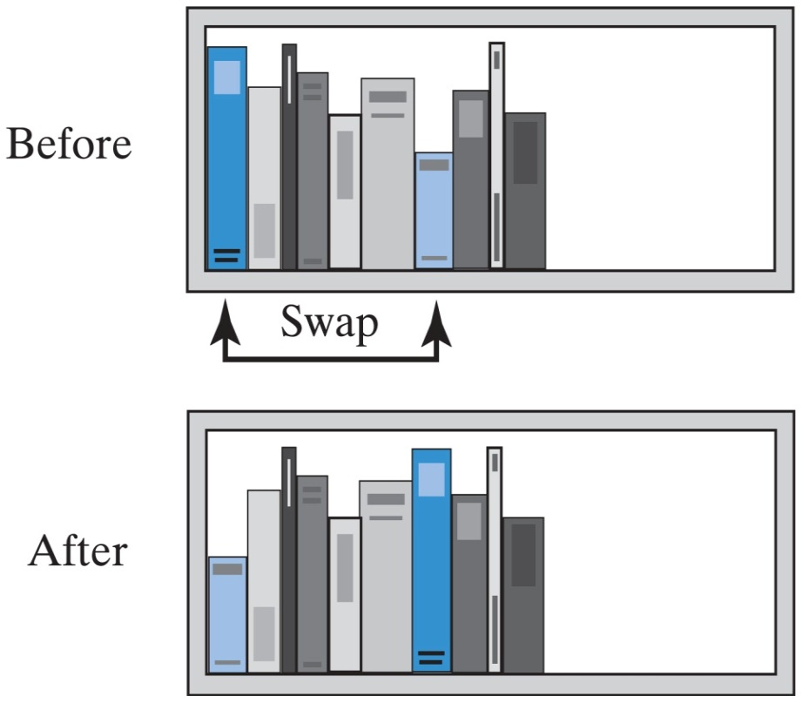
Selection Sort
Example of sorting books by height
  Look down shelf, select shortest
  Swap first with selected shortest
  Move to second slot, repeat process

Slide 11
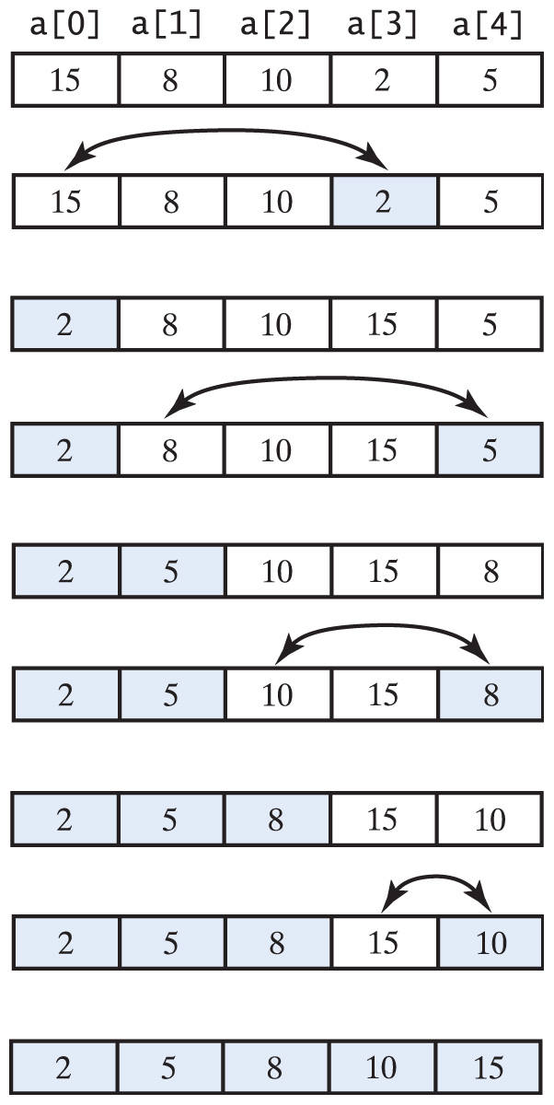
Selection Sort
Selection sort of an array of integers into ascending order.
See the visualization

Slide 12
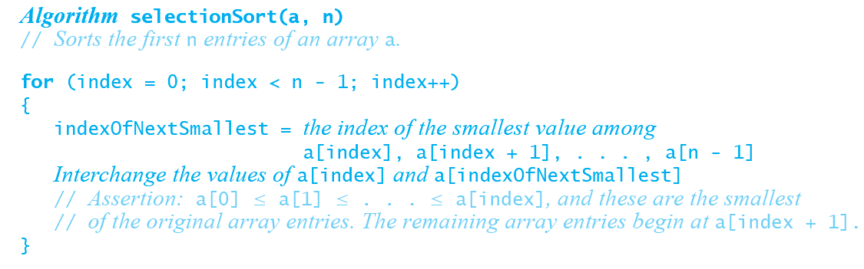
Selection Sort
Pseudocode for algorithm
View source code, Listing 8-1
Efficiency of selection sort, O(n²)
Does only O(n) swaps

Slide 13
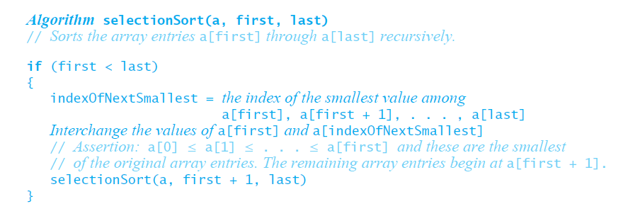
Recursive Selection Sort
Pseudocode for algorithm

Slide 14
Selection Sort - example
Trace the steps that a Selection sort takes when sorting the following array into ascending order: 9 6 2 4 8
2 6 9 4 8
2 4 9 6 8
2 4 6 9 8
2 4 6 8 9

Slide 15
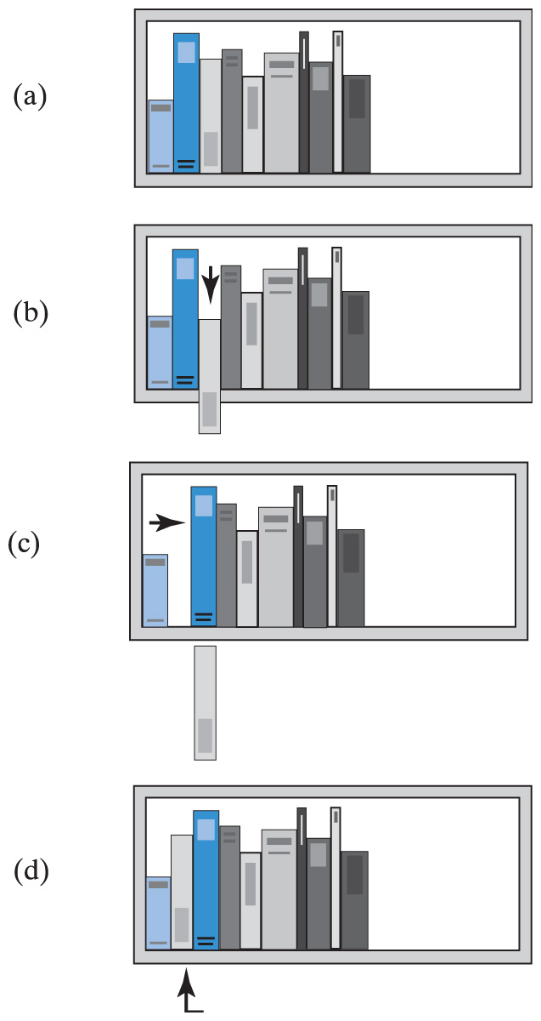
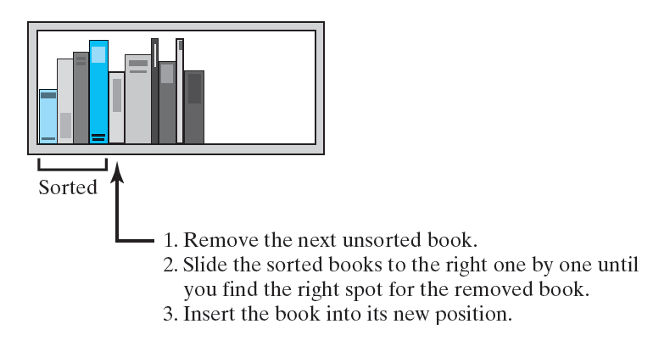
Insertion Sort
If the leftmost book on the shelf were the only book, your shelf would be sorted
Consider the second book
  If it is taller than the first book, you have two sorted books
  If not, you remove the second book, slide the first book to the right
  Insert the book you just removed into the first position on the shelf
  The first two books are now sorted
Now consider the third book
  If it is taller than the second book, you have three sorted books
  If not, you remove the third book, slide the second book to the right
  See if the book in your hand is taller than the first book
  If so, insert the book you just removed into the second position on the shelf
  If not, slide the first book to the right and insert the book at your hand into the first position on the shelf
  The first three books are now sorted
Continue …

Slide 16
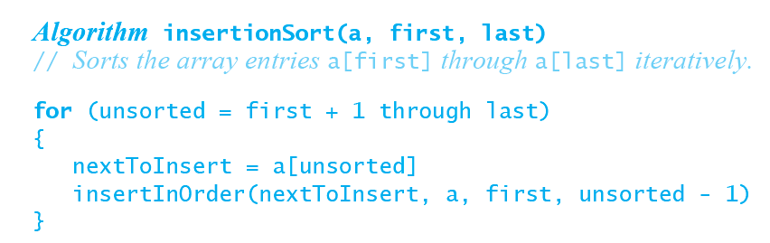
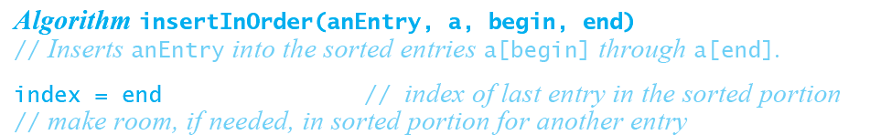
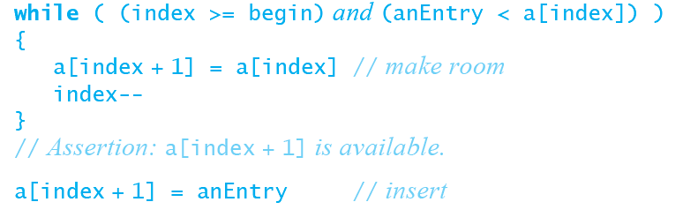
Insertion Sort - Algorithms

Slide 17
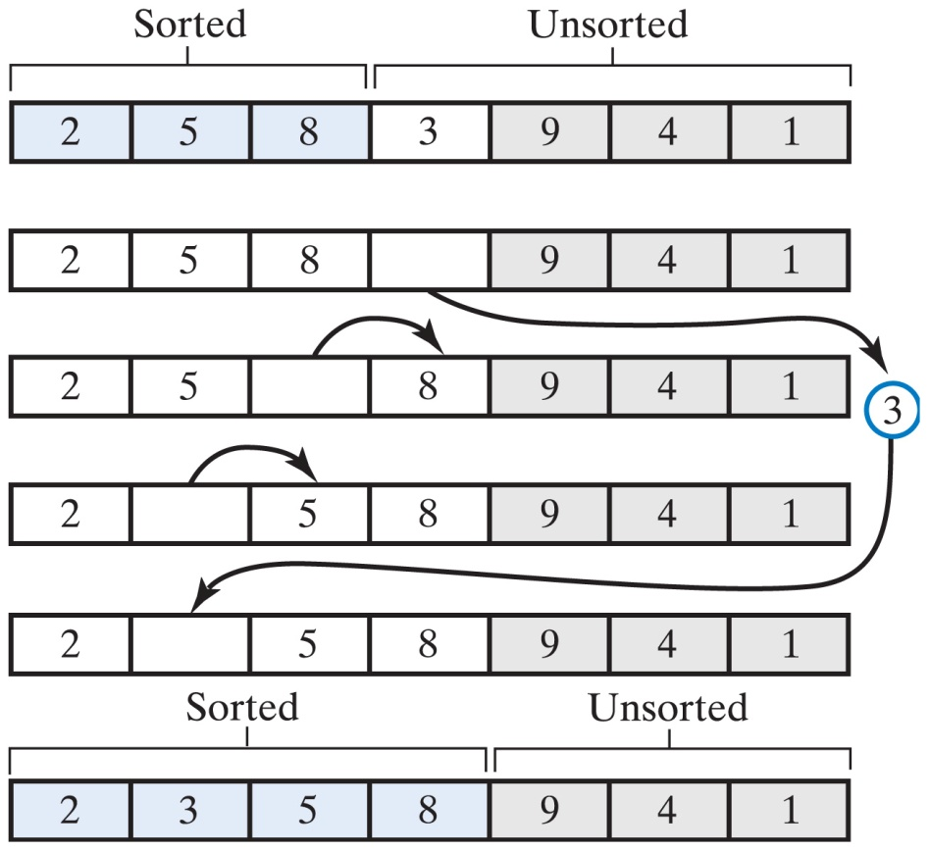
Iterative Insertion Sort
An Insertion sort inserts the next unsorted element into its proper location within the sorted portion of an array

Slide 18
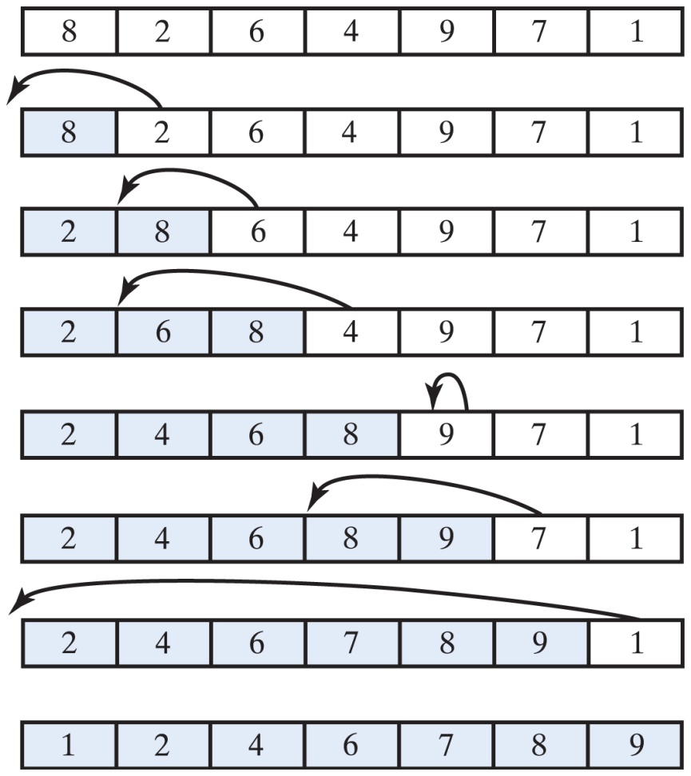
Iterative Insertion Sort
An insertion sort of an array of integers into ascending order
  See the visualization

Slide 19
Iterative Insertion Sort - example
Trace the steps that an Insertion sort takes when sorting the following array into ascending order: 9 6 2 4 8
temp
9 6 2 4 8 6
6 9 2 4 8 2
2 6 9 4 8 4
2 4 6 9 8 8
2 4 6 8 9 <- done

Slide 20
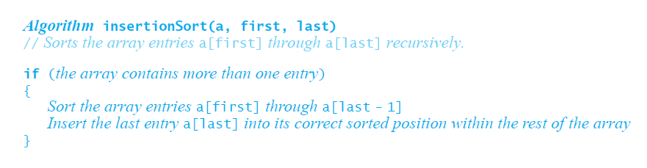
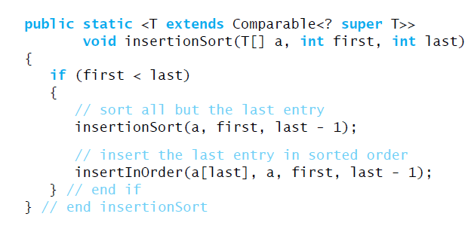
Insertion Sort
Recursive algorithm
Recursive Java method

Slide 21
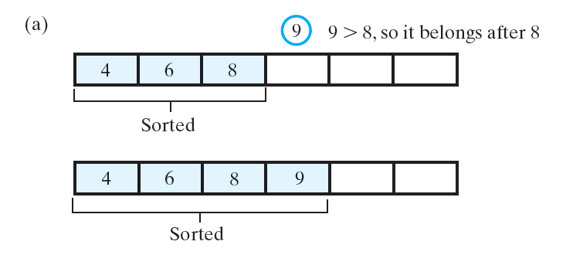
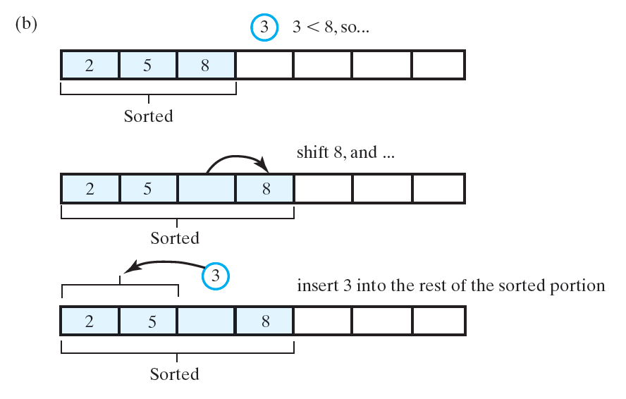
(a) The entry is greater than or equal to the last sorted entry;
Inserting the first unsorted entry into the sorted portion of the array:
(b) the entry is smaller than the last sorted entry

Slide 22
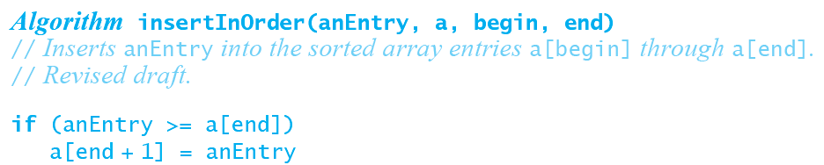
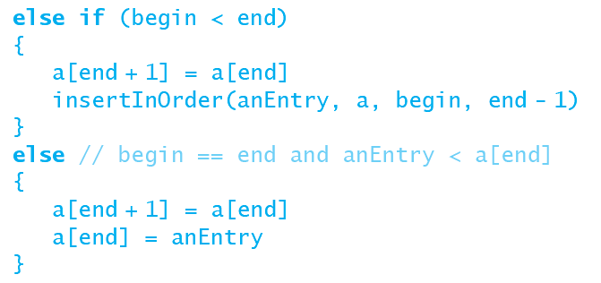
Insertion Sort
The algorithm insertInOrder:

Slide 23
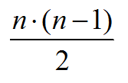
Insertion Sort
Efficiency
  Loop executes at most
  1 + 2 + … (n – 1) times
  Sum is
  Which gives O(n²)
Best case – array already in order, O(n)

Slide 24

Insertion Sort of a Chain of Linked Nodes
Consider inserting node in a sorted chain in correct position
First locate where it should go
  Make comparisons from head towards end of chain
  During chain traversal, keep reference to previous node of comparison

Slide 25
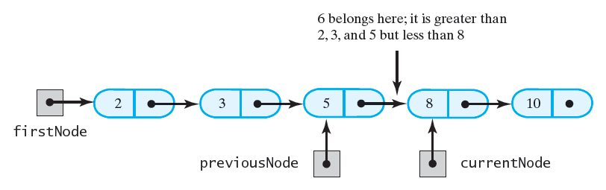
Figure 8-10 During the traversal of a chain to locate the insertion point, save a reference to the node before the current one
Insertion Sort of a Chain of Linked Nodes

Slide 26
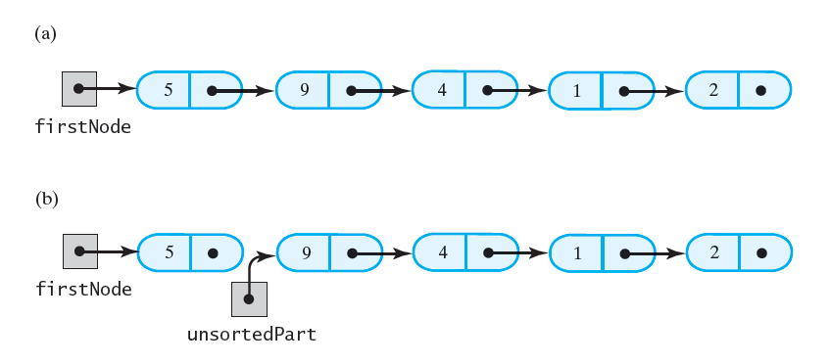
Figure 8-11 Breaking a chain of nodes into two pieces as the first step in an insertion sort: (a) the original chain; (b) the two pieces
Insertion Sort of a Chain of Linked Nodes

Slide 27
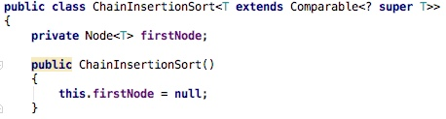
Insertion Sort of a Chain of Linked Nodes
Consider a class which holds a collection with linked list
We will add a sort method to
  see the ChainInsertionSort class
  see next slide

Slide 28
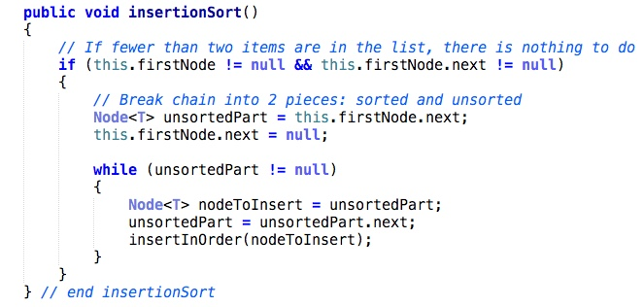
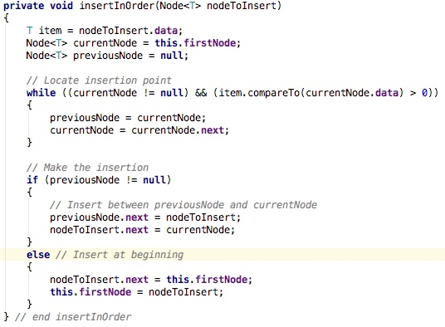
Insertion Sort of a Chain of Linked Nodes
Trace the algorithm for the following chain of nodes:

Slide 29
Insertion Sort of a Chain of Linked Nodes
Efficiency
  As before, loop executes at most
  1 + 2 + … (n – 1) times
  Results in efficiency of O(n²)
Insertion sort is reasonable way to sort chain of linked nodes

Slide 30
Shell Sort
Improved insertion sort developed by Donald Shell
  faster than O(n²)
Done by sorting sub-arrays of equally spaced indices
  Initial separation between indices to n/2
Instead of moving to an adjacent location an element moves several locations away
  Results in an almost sorted array
  Next, this array sorted efficiently with ordinary insertion sort

Slide 31
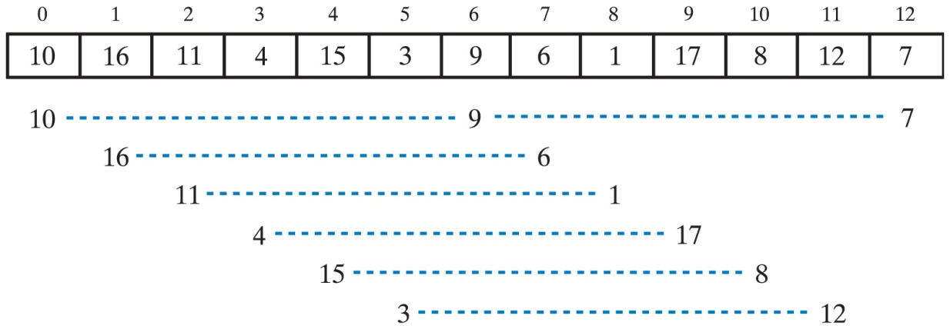
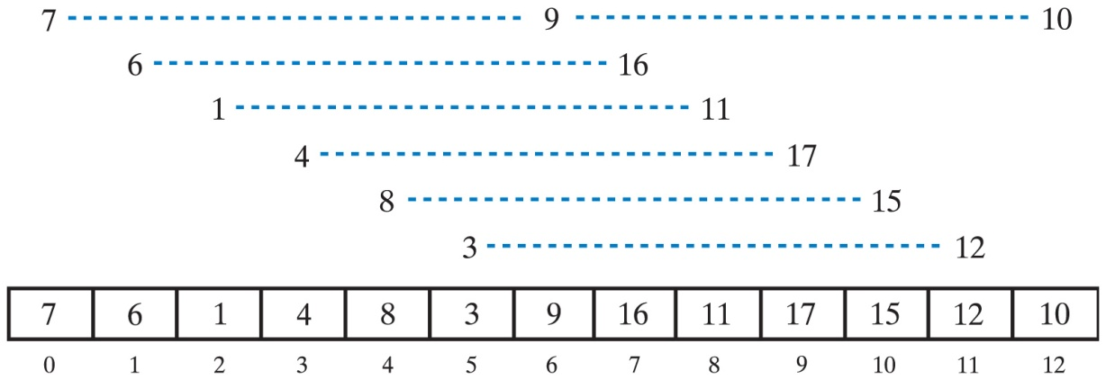
Shell Sort
An array and the subarrays formed by grouping elements whose indices are 6 apart.
The subarrays after they are sorted, and the array that contains them.

Slide 32
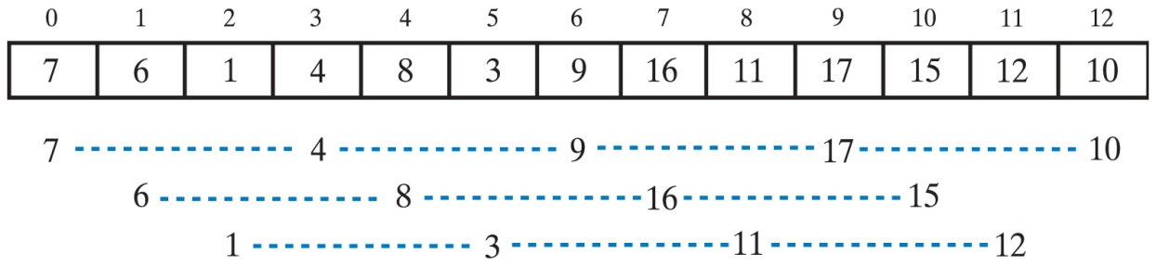
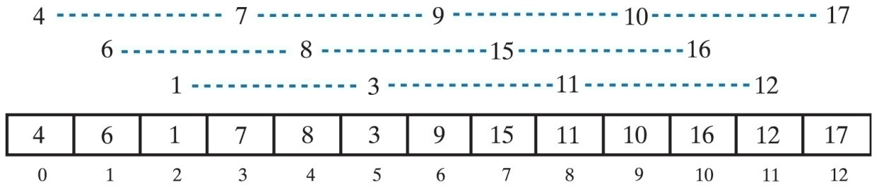
Shell Sort
The subarrays of the array formed by grouping elements whose indices are 3 apart.
The subarrays after they are sorted, and the array that contains them.
See demo

Slide 33
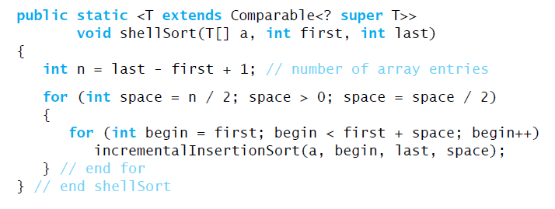
Shell Sort – Java Code
Incremental Insertion Sort
Method which calls the IncrementalInsertionSort

Slide 34
Shell Sort - example
Apply the Shell sort to the array 9 8 2 7 5 4 6 3 1, with index separations of 4, 2, and 1.
temp
9 8 2 7 5 4 6 3 1 5
5 8 2 7 9 4 6 3 1 1
1 8 2 7 5 4 6 3 9 4
1 4 2 7 5 8 6 3 9 6
1 4 2 7 5 8 6 3 9 3
1 4 2 3 5 8 6 7 9 2
1 4 2 3 5 8 6 7 9 5
1 4 2 3 5 8 6 7 9 6
1 4 2 3 5 8 6 7 9 9
1 4 2 3 5 8 6 7 9 3
1 3 2 4 5 8 6 7 9 8
1 4 2 3 5 8 6 7 9 7
1 3 2 4 5 7 6 8 9 ← starting insertion sort at this point
1 2 3 4 5 7 6 8 9
1 2 3 4 5 6 7 8 9 ← done

Slide 35
Efficiency of Shell Sort
Efficiency is O(n²) for worst case
  The initial increment sequence suggested by Donald Shell was [1,2,4,8,16,...,2^{k}], but this is a very poor choice in practice because it means that elements in odd positions are not compared with elements in even positions until the very last step.
Can be improved:
  This simple change results in consecutive increments that have no factor in common
  This also results in O(n^{1.5})
Any time the variable space is even, add 1 to improve the worst-case behavior

Slide 36
Question
Apply the improved Shell sort to the array of letters:
  I H B G E D F C A
Show all the steps.

Slide 37
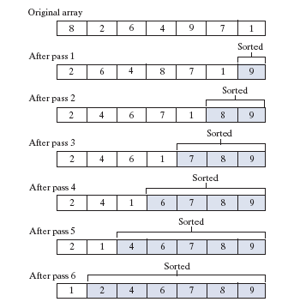
Remember Bubble Sort ?
public static <T extends Comparable<? super T>> void bubbleSort(T[] a)
{
int leftIndex = 0; // first position to check
int rightIndex = a.length - 1; // last position to check
while (leftIndex < rightIndex) // number of passes
{
for (int index = leftIndex; index < rightIndex; index++)
{
if (a[index].compareTo(a[index + 1]) > 0)
{
swap(a, index, index + 1);
}
}
rightIndex--;
}
}

Slide 38
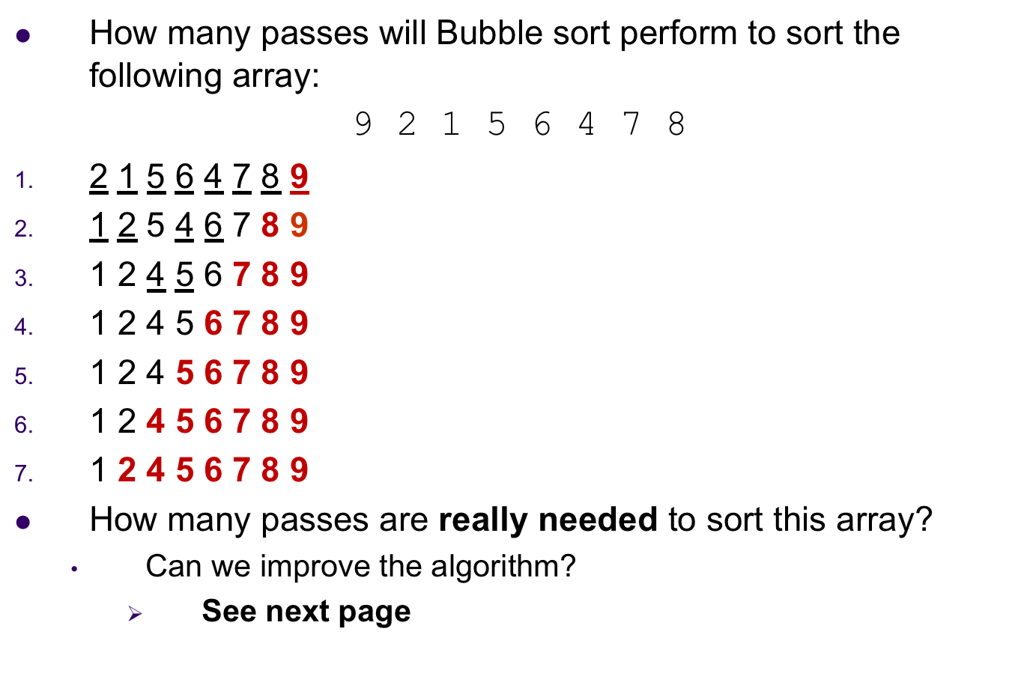
Bubble Sort - example

Slide 39
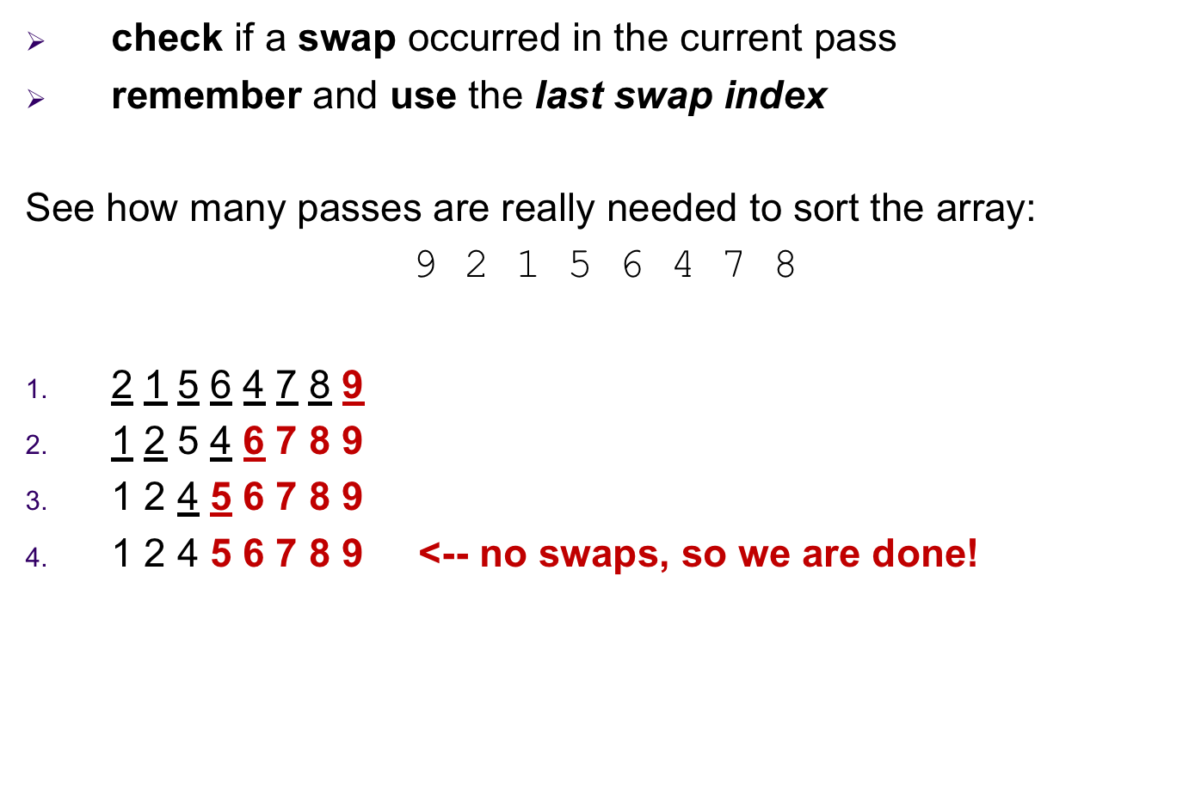
Improved Bubble Sort

Slide 40
Shaker Improved Bubble Sort:
  The direction of “bubbling” changes in each iteration:
    in one iteration, the largest element is bubbled up (traversing from left to right)
    in the next the smallest element is bubbled down (traversing from right to left)
    in the next the second largest is bubbled up
    in the next the second smallest is bubbled down
    and so forth
Try the following array with:
      5 7 4 3 9 8 5 6
    regular Bubble sort
    Improved Bubble sort
    Shaker Improved Bubble sort
Regular Bubble sort in the worst and average case is O(n²) . Its best case is O(n). In comparison with the other sorts, it is not an improvement in efficiency.

Slide 41
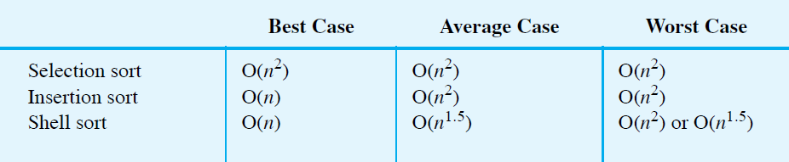
Comparing the Algorithms
The time efficiencies of three sorting algorithms, expressed in Big Oh notation.
See side-by-side demo

